Slide 1
Secure Data Hiding in Image Using Steganography
CAPSTONE PROJECT
Presented By: ARI CHANDRAN YOGANANDH
College Name & Department : MALLA REDDY COLLEGE OF ENGINEERING AND TECHNOLOGY

Slide 2
OUTLINE
Problem Statement
Technology used
Wow factor
End users
Result
Conclusion
Git-hub Link
Future scope

Slide 3
Problem Statement
Traditional encryption methods are easily detectable and can attract unwanted attention.
Steganography allows secure data hiding without raising suspicion.
There is a need for a user-friendly tool to encode and decode secret messages efficiently.
Existing tools lack an intuitive interface, making them difficult for non-technical users.
Secure communication is crucial for privacy-conscious users and professionals handling sensitive data.

Slide 4
Technology used
Programming Language: Python
GUI Framework: Tkinter
Image Processing: PIL (Pillow)
Steganography Libraries: Stepic (if used), custom LSB encoding
IDE: VS Code

Slide 5
Wow factors
Hacker-Themed UI: Engaging and visually appealing dark mode interface.
Easy-to-Use Interface: Simple and intuitive encoding/decoding process.
Lightweight & Fast: Efficiently hides and retrieves messages without significant processing delays.
Cross-Platform Compatibility: Can run on different operating systems without complex installations.
Potential for Expansion: Future updates can include encrypted steganography, multi-image support, and password protection.

Slide 6
End users
Government and Intelligence Agencies
Journalists and Whistleblowers
Corporate Organizations for Secure Data Transfer
Military and Defense Personnel
General Users Concerned About Privacy

Slide 7
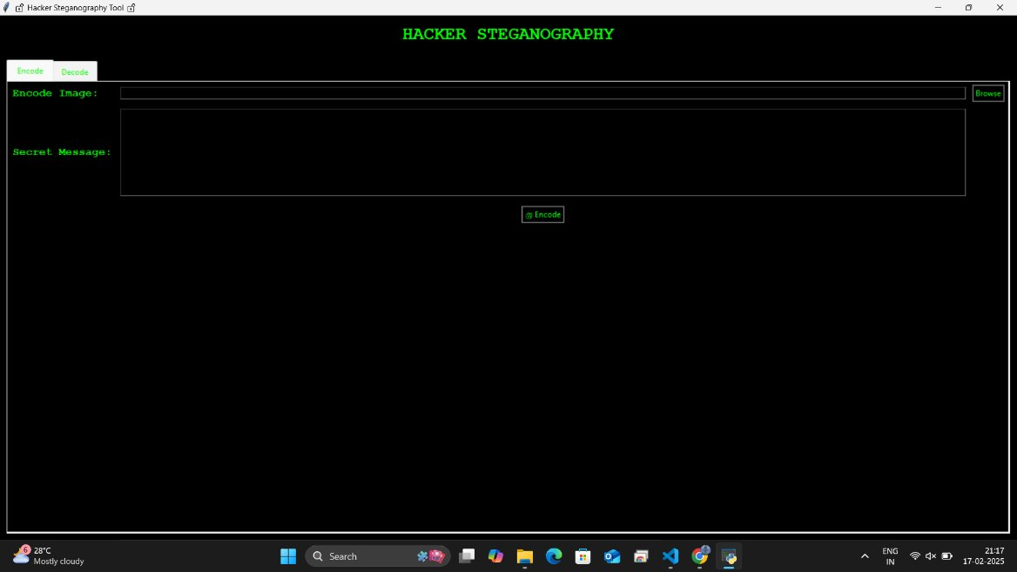
Results
Main Screen Of The Output

Slide 8
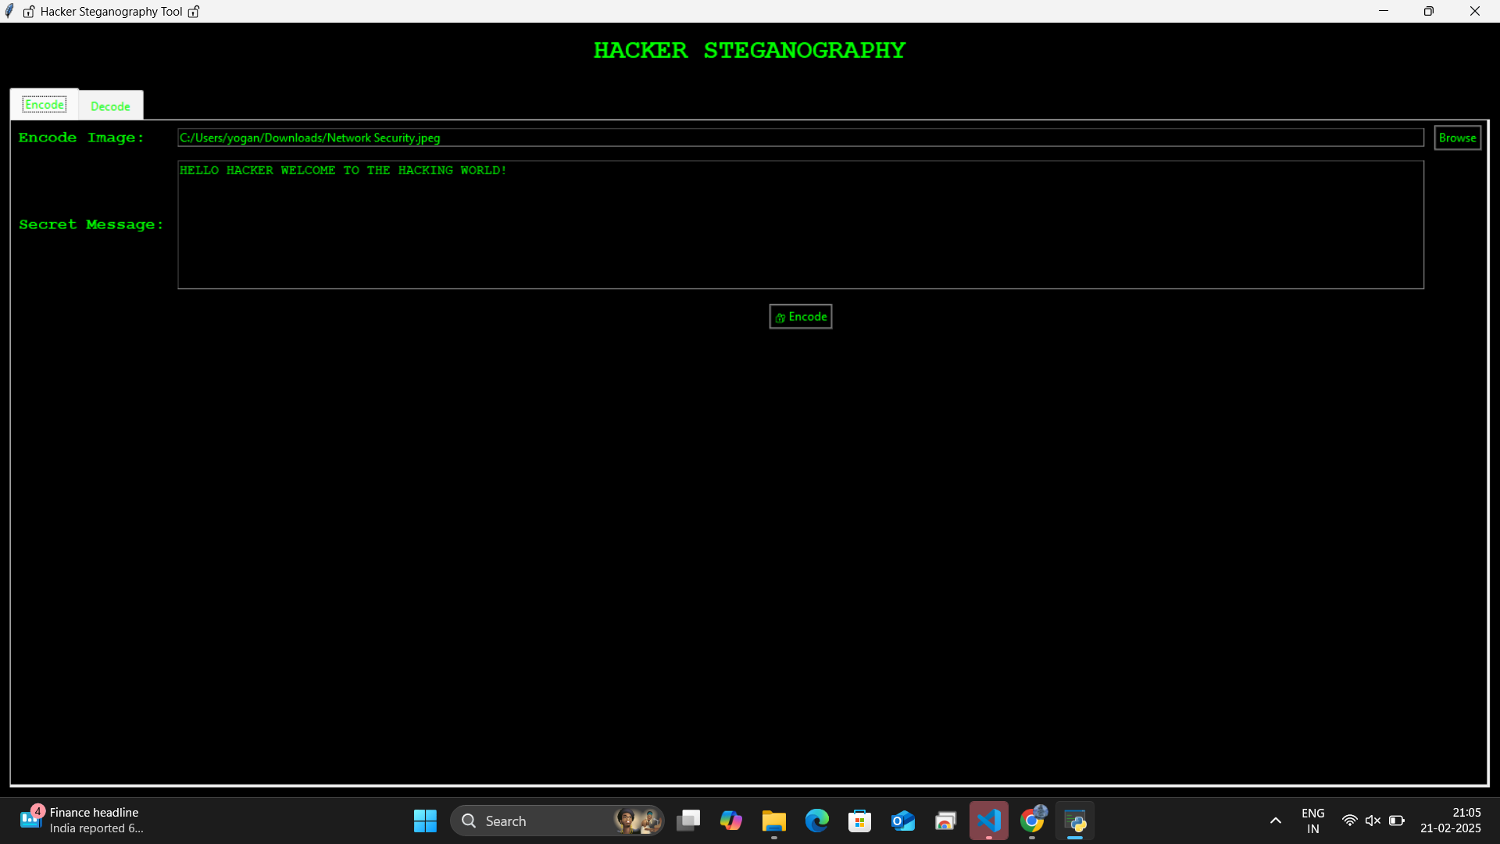
ENCODING

Slide 9
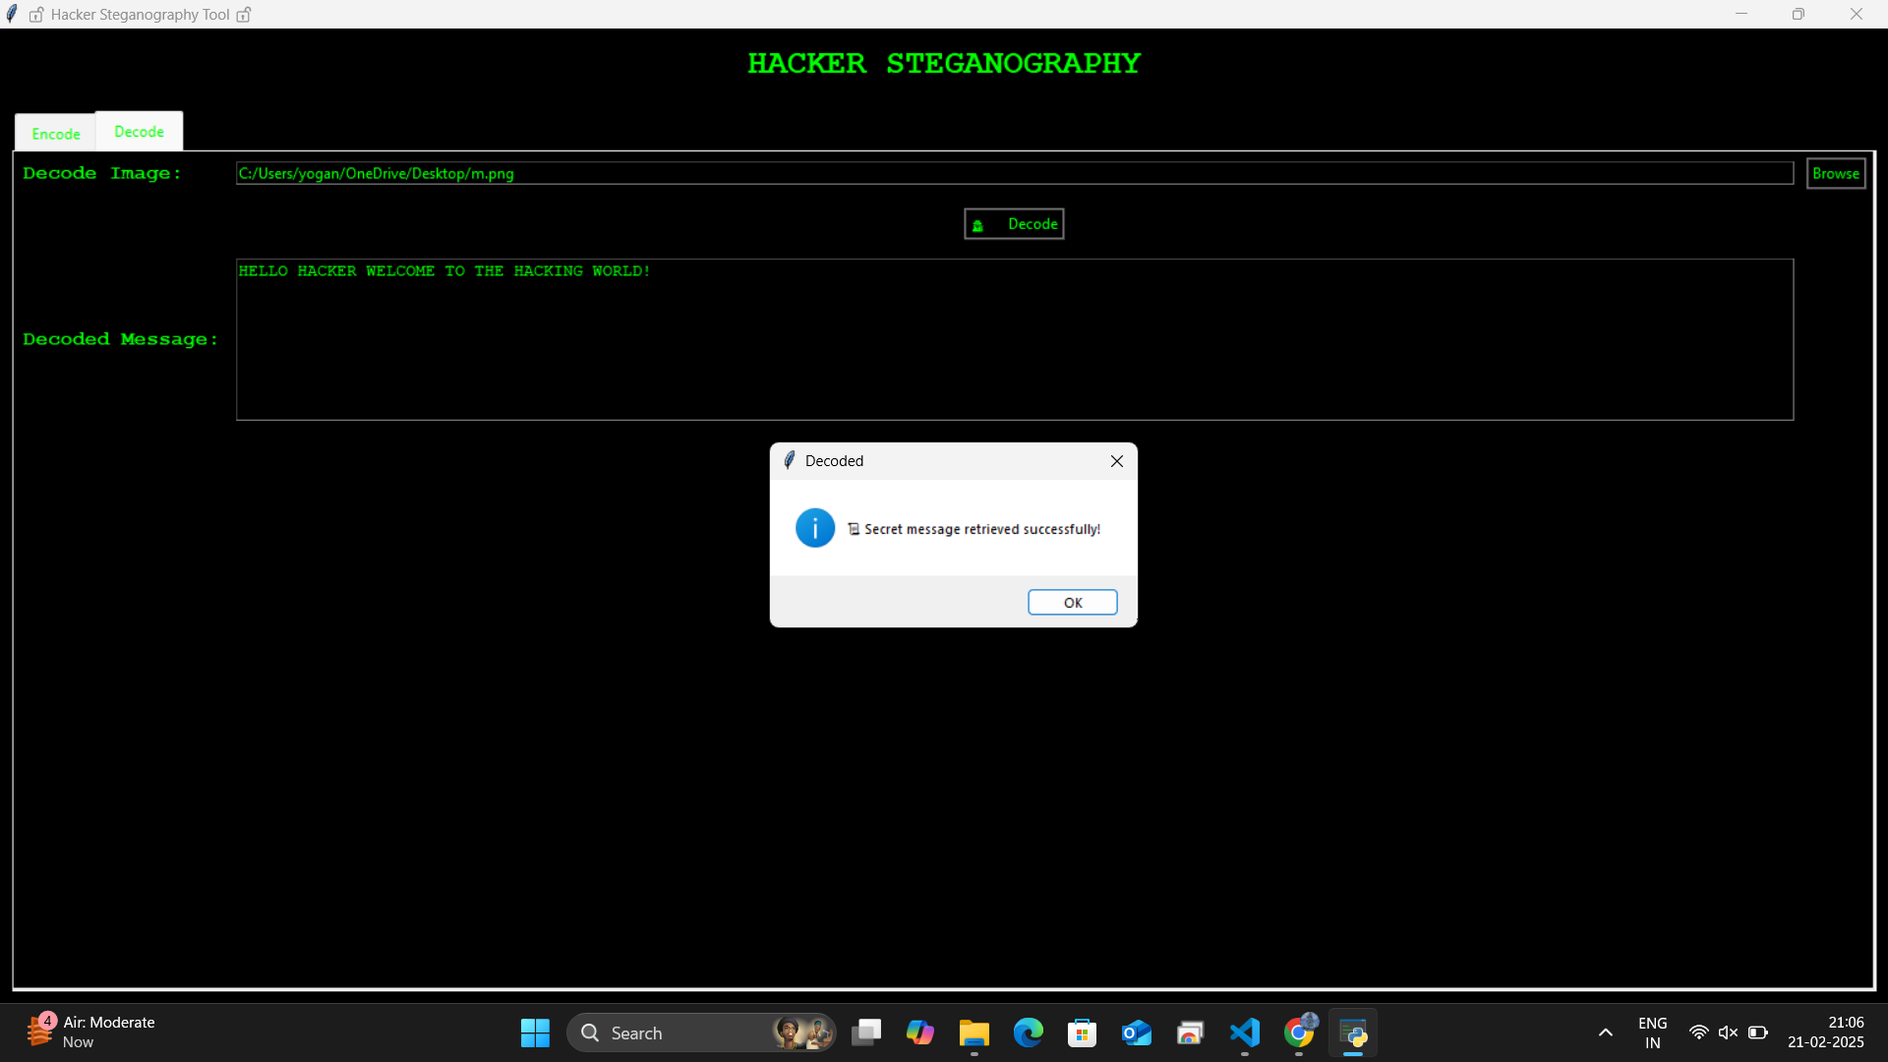
DECODING

Slide 10
Conclusion
Fully Functional: The steganography tool now correctly encodes and decodes secret messages in images.
Error Handling Improved: Proper error messages guide users when selecting files or entering messages.
Efficient Encoding: Uses LSB (Least Significant Bit) technique to hide messages in image pixels.
Optimized Decoding: Ensures hidden messages are extracted accurately with a termination marker ("###") for clarity.
Hacker-Themed UI: A sleek dark mode interface with neon green text enhances the "hacker" aesthetic.

Slide 11
GitHub Link
https://github.com/JERRY07-YOGA/Secure-Image-Stegnography

Slide 12
Future scope(optional)
Enhanced Security – Implementing quantum-resistant encryption and AI-based steganalysis detection to improve data security.
Multi-Format Support – Expanding to support audio, video, and document-based steganography for broader applications.
Cloud Integration – Enabling secure cloud storage and sharing of steganographic images for remote communication.
Automated Detection & Prevention – Developing AI-powered tools to detect and prevent malicious steganographic attacks.
Steganography for IoT – Applying lightweight steganography techniques for secure communication in IoT devices.

Slide 13
THANK YOU

